Slide 1
PROTOCOL DATA UNIT & TCP/IP REFERENCE MODEL -by Hitesh Nautiyal

Slide 2
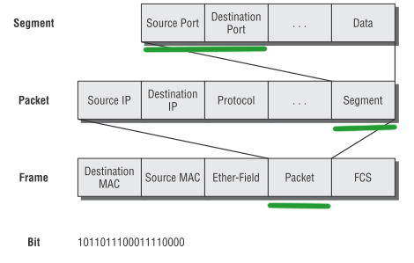
PROTOCOL DATA UNIT(PDU):-

Slide 3
EXPLAIN PDU :-
a protocol data unit (PDU) is the basic unit of exchange between entities that communicate using a specified networking protocol. When working with a multilayer protocol stack, like the TCP/IP networking suite, use of the correct PDU is important when discussing protocol interactions.
The PDU defines what a protocol message should look like, and PDUs typically consist of the following:
Protocol header, a sequence of fields that contain specific data about the PDU. Most protocol headers include fields for a destination address and a source address. Protocol headers can be fixed length or variable length, depending on the protocol specification.
Protocol body or payload, the information being transmitted by the protocol.
Protocol trailer, a sequence of bits attached to the PDU, after the payload. Protocol trailers are most commonly encountered in data link layer (Layer 2) protocols; at higher layers, PDU length is signaled in a header field. PDU trailers are a part of the Ethernet protocol, where a four-octet (32-bit) field containing a cyclic redundancy check, or CRC, value for the Ethernet frame follows the payload of the frame.

Slide 4
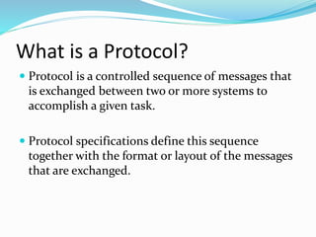
PROTOCOL :-

Slide 5
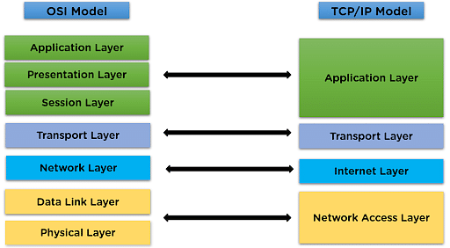
TCP/IP REFERENCE MODEL :-

Slide 6
1) Host-to-Network Layer
Lowest layer of the all.
Protocol is used to connect to the host, so that the packets can be sent over it.
Varies from host to host and network to network.

Slide 7
2) Internet Layer
Selection of a packet switching network which is based on a connectionless internetwork layer is called a internet layer.
It is the layer which holds the whole architecture together.
It helps the packet to travel independently to the destination.
Order in which packets are received is different from the way they are sent.
IP (Internet Protocol) is used in this layer.
The various functions performed by the Internet Layer are:
Delivering IP packets
Performing routing
Avoiding congestion

Slide 8
3) Transport Layer
It decides if data transmission should be on parallel path or single path.
Functions such as multiplexing, segmenting or splitting on the data is done by transport layer.
The applications can read and write to the transport layer.
Transport layer adds header information to the data.
It defines two end-to-end protocols: TCP and UDP
TCP(Transmission Control Protocol): It is a reliable connection-oriented protocol which handles byte-stream from source to destination without error and flow control.
UDP(User-Datagram Protocol): It is an unreliable connection-less protocol that do not want TCPs, sequencing and flow control. Eg: One-shot request-reply kind of service.

Slide 9
4) Application Layer
The TCP/IP specifications described a lot of applications that were at the top of the protocol stack. Some of them were TELNET, FTP, SMTP, DNS etc.
TELNET is a two-way communication protocol which allows connecting to a remote machine and run applications on it.
FTP(File Transfer Protocol) is a protocol, that allows File transfer amongst computer users connected over a network. It is reliable, simple and efficient.
SMTP(Simple Mail Transport Protocol) is a protocol, which is used to transport electronic mail between a source and destination, directed via a route.
DNS(Domain Name Server) resolves an IP address into a textual address for Hosts connected over a network.
It allows peer entities to carry conversation.

